Slide 1
SECURE DATA HIDING IN IMAGES USING STEGANOGRAPHY
CAPSTONE PROJECT
Presented By
Student Name : NAGAVATH RAHUL KUMAR
College Name & Department : GURU NANAK INSTITUTIONS
TECHNICAL CAMPUS, CSE

Slide 2
OUTLINE
Problem Statement
Technology used
Wow factor
End users
Result
Conclusion
Git-hub Link
Future scope

Slide 3
Problem Statement
With the increasing need for secure communication and data protection, conventional encryption methods may not always be sufficient to ensure privacy. Cyber threats and unauthorized access to sensitive information pose significant risks in various domains, including defense, healthcare, and finance. Steganography, the practice of concealing data within digital media, offers an additional layer of security by making the existence of the hidden data undetectable.

Slide 4
Technology used
Libraries:
Open-cv
Operating System(OS)
Strings
Plat Form:
VS-Code
Python-IDE
Git Hub

Slide 5
Wow factors
Implementing an efficient and robust steganographic technique while maintaining the quality of the cover image remains a challenge. This project aims to develop a secure and effective method for embedding and extracting hidden data within images, ensuring minimal perceptual distortion and resilience against detection or modification.

Slide 6
End users
Individuals
Organizations
Enterprises
Government & Defense
Cloud & Technology Providers
Blockchain & Crypto Currency
Developers

Slide 7
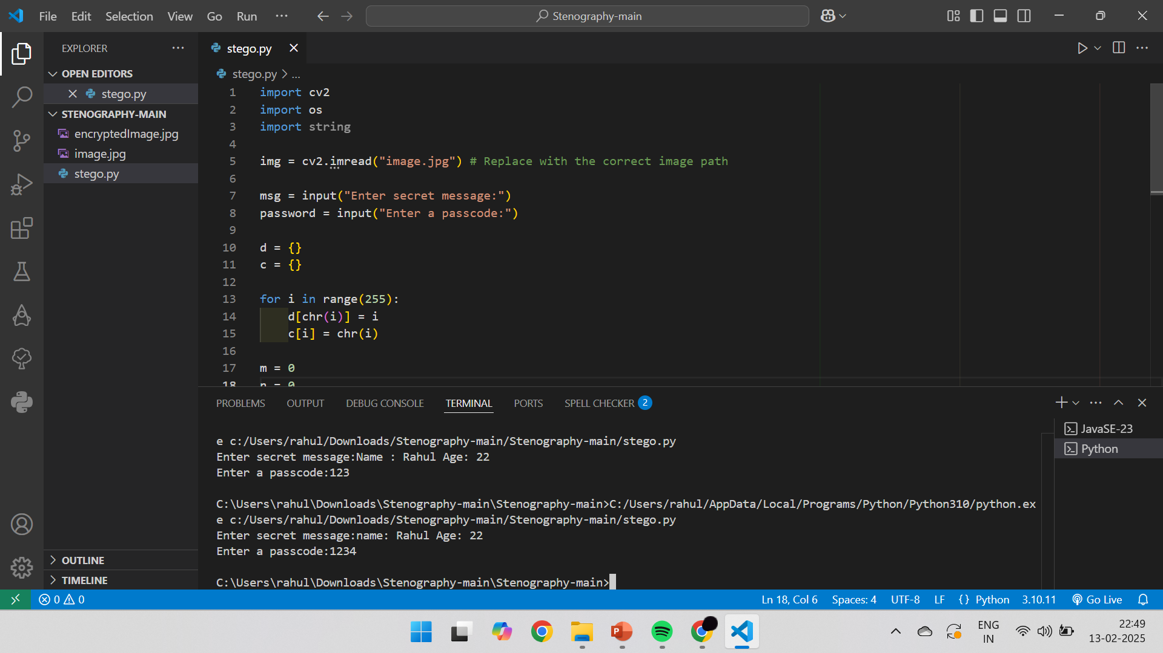
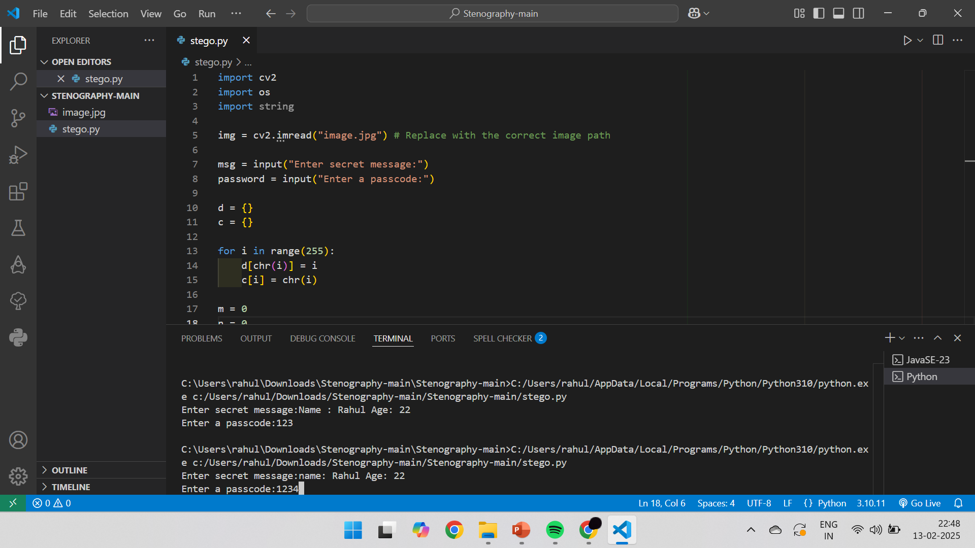

Results

Slide 8
Conclusion
This project highlights the significance of image-based steganography in various applications, including secure messaging, digital watermarking, and confidential data storage. By implementing robust encoding and decoding techniques, we can ensure minimal distortion to the cover image while maximizing the security and imperceptibility of hidden information.
As cyber threats continue to evolve, combining steganography with cryptographic techniques can further strengthen data security, making it more resilient against detection and attacks. Future advancements in artificial intelligence and quantum computing may lead to more sophisticated steganographic methods, ensuring the continuous improvement of secure data hiding techniques.

Slide 9
GitHub Link
https://github.com/rahul2317-NRK/Aicte-project.git

Slide 10
THANK YOU

